Slide 1

Office of Technology Tansfer and Innovation
IP BASICS
Chanelle Mack
Director, Licensing

Slide 2
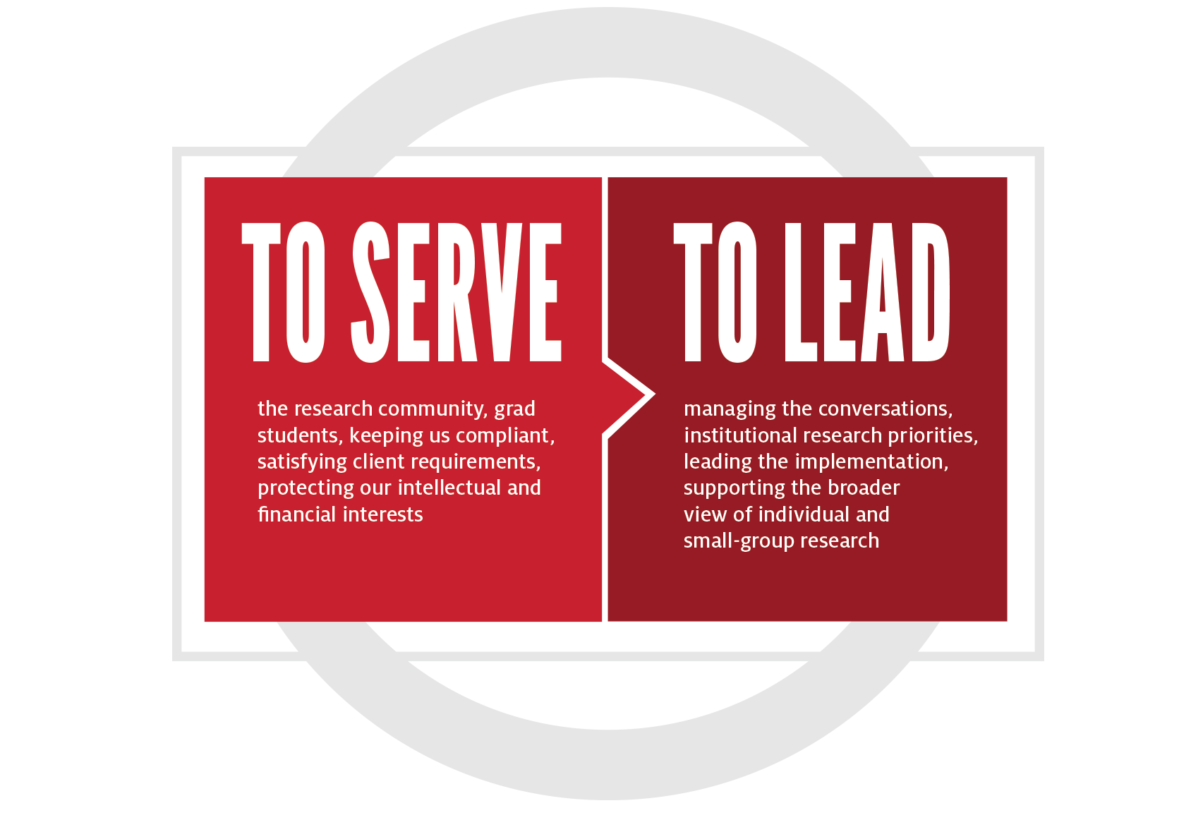

Slide 3
OTTI- Purpose and Activity sets
The team purpose is to foster research and scholarship through the effective transfer and commercialization of University technology in the following activity sets.
Patenting
Activity Set
Technology Bridge
Activity Set
Licensing
Activity Set
Facilitate the generation of IP and provide effective stewardship of the UH IP portfolio.
Promote collaborations with industry partners and startups to scale up and commercialize technology.
Evaluate and market IP, execute licenses, and IP portions of research agreements.

Slide 4
What is Intellectual Property (IP)
Patents
Know-how (Research tools including cell lines, antibodies, mouse models etc.)
Copyrights
Trademarks

Slide 5
Why are patents important?
Patents provide exclusive rights to exploit inventions for 20 years from the date of filing
Strong market position
Opportunity to license the invention
Patents are the core of a large number of SMEs
Source: WIPO

Slide 6
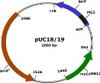
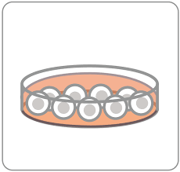
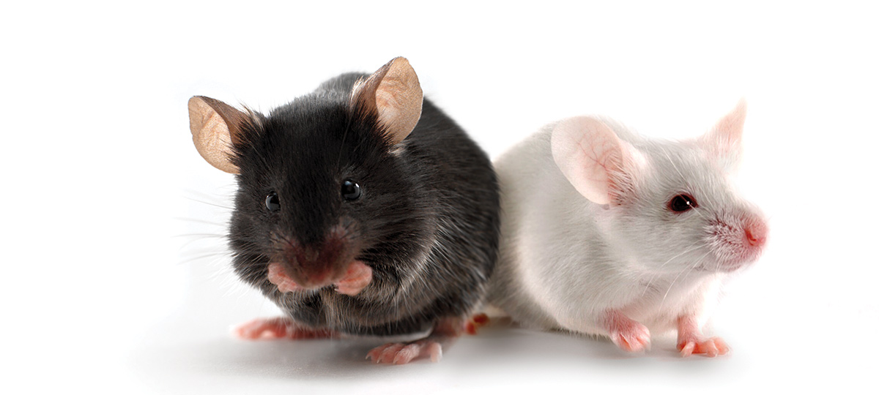
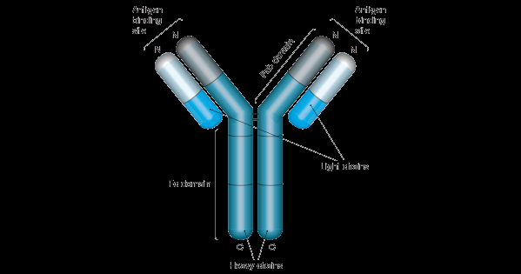
Non-patentable inventions
Not everything is patentable
But, IP can be licensed without a patent
Cell lines
Antibodies
Mouse models
Plasmids
Software (copyrights)
* Disclose your patentable or non-patentable idea to OTTI

Slide 7
One year statutory bar
A patent application is required to be filed within one year of public use of the invention.
Public Use includes the following:
    a sale of or offer to sell the invention, or any publication describing the invention.
If the applicant fails to file a patent for their invention within one year of those, then the applicant is barred from filing a patent.

Slide 8
DOs and DON’Ts
Do:
  Keep your idea confidential.
  Consult an your Technology Transfer Office/Attorney if you think that you have a new idea that is patentable.
  Begin the process of putting that idea to use. (However, you do not need a prototype to file a patent.)
  Research your idea to be sure that it hasn’t been done before
Don’t:
  PUBLISH YOUR IDEA before submission of a patent application!!!!
  POST YOUR IDEA ON SOCIAL MEDIA!!!!
  Speak with a potential business partner without a non-disclosure agreement in place.
  Agree to a partnership with another entity a legally enforceable agreement in place.

Slide 9
What is a copyright?
Copyright is a type of intellectual property that protects original works of authorship as soon as an author fixes the work in a tangible form of expression.
The length of copyright protection depends on when a work was created. Under the current law, works created on or after January 1, 1978, have a copyright term of life of the author plus seventy years after the author’s death.

Slide 10
Types of works
In copyright law, there are a lot of different types of works that qualify for copyright protection including:
  paintings,
  photographs,
  illustrations,
  musical compositions,
  sound recordings,
  computer programs,
  books,
  poems,
  blog posts,
  movies,
  architectural works,
  plays, and so much more!

Slide 11
Owning a copyright vs copyright registration
Copyright exists automatically in an original work of authorship once it is fixed to a tangible medium, but a copyright owner can take steps to enhance the protections. The most important step is registering the work.
Registering a work is not mandatory, but for U.S. works, registration (or refusal) is necessary to enforce the exclusive rights of copyright through litigation.

Slide 12
What is a trademark?
A trademark can be any word, phrase, symbol, design, or a combination of these things that identifies your goods or services. It’s how customers recognize you in the marketplace and distinguish you from your competitors.
The word “trademark” can refer to both trademarks and service marks. A trademark is used for goods, while a service mark is used for services.
A trademark:
  Identifies the source of your goods or services.
  Provides legal protection for your brand.
  Helps you guard against counterfeiting and fraud.

Slide 13
Owning a trademark vs trademark registration
You become a trademark owner as soon as you start using your trademark with your goods or services. You establish rights in your trademark by using it, but those rights are limited, and they only apply to the geographic area in which you’re providing your goods or services.
If you want stronger, nationwide rights, you’ll need to apply to register your trademark with the United States Patent and Trademark Office (USPTO).

Slide 14
What is a trade secret?
Trade secrets are intellectual property (IP) rights on confidential information which may be sold or licensed.
In general, to qualify as a trade secret, the information must be:
  commercially valuable because it is secret,
  be known only to a limited group of persons, and
  be subject to reasonable steps taken by the rightful holder of the information to keep it secret, including the use of confidentiality agreements for business partners and employees.
The unauthorized acquisition, use or disclosure of such secret information in a manner contrary to honest commercial practices by others is regarded as an unfair practice and a violation of the trade secret protection.

Slide 15
How to protect a trade secret
Non-disclosure agreement (NDA): employees and business partners should sign a non-disclosure agreement that prevent them from disclosing a company’s confidential information.
Non-compete agreement (NCA): employers should ask employees, contractors and consultants to sign a non-compete agreement to prevent them from entering in competition when their employment/service agreement ends.
Robust IT security infrastructure
Controlling the accessibility of important documents

Slide 16










Technology Commercialization Cycle
Startup Formation
Publication
Marketing
Patent
Licensing
Early Stage Startup
Invention Disclosure
(research driven)
Startup Exit
Existing Business
Research
Late Stage Startup
Revenue generation
Notes:
Everything starts with Faculty. We are working very hard to change the culture in the Tech Transfer team to ensure they are a service first organization.

Slide 17



WIPO/USPTO/UH Processes
Invention Disclosure
2-3 weeks
90 days
Provisional Patent Application Filing
≈ $2000
10 Months from date of filing
Publish
Marketing
12 Months
Intellectual Property Committee Decision
Licensing
Non- Provisional Patent Application/PCT Filing
≈$20,000 -$30,000
18 months
Foreign filing Decisions
≈$20,000 -$30,000
+
$20,000/country
Patent Issued by individual country

Slide 18
WIPO/USPTO/UH Processes
Invention Disclosure
90 days
Provisional Patent Application (Prov) Filing
≈ $1000 -2000
Publish
10 Months from date of Prov filing
Intellectual Property Committee Decision
4+ years
(USA)
≈ $10,000 -30,000
Non-Provisional Patent Application/PCT Filing
18 months from date of filing
≈ $10,000 -20,000/ additional country
Foreign filing Decisions
12+ months from date of filing
Patent Issued by Individual Country

Slide 19
UH Process- Marketing and Licensing
Invention Disclosure
Provisional Patent Application Filing
Marketing
Publish
Intellectual Property Committee Decision
Term Sheet
Non- Provisional Patent Application Filing
Foreign filing Decisions
License Agreement
Patent Issued

Slide 20
UH Process
Invention Disclosure
2-3 weeks
90 days
Provisional Patent Application Filing
≈ $2000
10 Months from date of filing
Publish
Marketing
Intellectual Property Committee Decision
12 Months
Non- Provisional Patent Application Filing
Licensing
≈$20,000 -$30,000
18 months
Foreign filing Decisions
≈$20,000 -$30,000
+
$20,000/country
Patent Issued

Slide 21
Patenting- Critical Steps
Intellectual Property Committee Decision
IPC decision making criteria
Actively engaged in licensing conversations
Industry collaborator/partner
Patentability
Solves an unmet need in the market
Non- Provisional Patent Application Filing
Foreign Filing Criteria
Patent licensed to a Licensee (UH files in 3 additional countries)
Licensee pays for foreign filings
18 months
Foreign filing Decisions

Slide 22
Licensing- Critical Steps
Active (Industry Outreach)
Inventors help identify right licensees
Talking to the industry- most effective marketing
Marketing
Passive (DOR-OTTI Website)
OTTI prepares one-page marketing flyers
Attracts technology scouts from the industry
Term Sheet
Perform due-diligence on identified licensees
Inventors role in licensing?
Negotiate license agreements (BoR Policy, Section III, 21.08)
Licensing

Slide 23
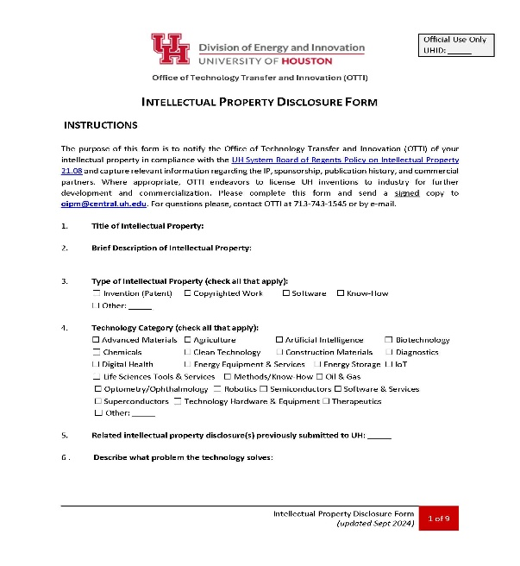
You might have the next blockbuster idea, what should you do?
Don’t publicly disclose your idea (publications, presentations, talks etc.)
Complete a new invention disclosure form (IDF) and send it to us at oipm@central.uh.edu 90 days before any anticipated disclosure
Answer a few questions and give us more information about your invention
In-house patent experts will look at the invention and conduct interviews with you
Outside Counsel will work with you to get the patent filed
IDF can be found online : https://uh.edu/uh-energy-innovation/uh-innovation/technology-transfer/

Slide 24
CONTACT INFORMATION
Rick James
Director, Technology Commercialization
rfjames@central.uh.edu
713-743-0201
Chanelle Mack
Director, Licensing
cnmack@central.uh.edu
713-743-9722
Mingwei Chen
Technology Transfer Associate
mchen51@central.uh.edu
713-743-8376
Nelson Hawkins
Program Manager, IP Operations
nkhawkin@central.uh.edu
713-743-1545

